Slide 1

Movies analysis 9000+ Movies Dataset

Slide 2
AGENDA
Main Idea
Columns Info
Dashboard
Summary

Slide 3
Introduction

Slide 4
What is the project about?
Main Idea
Stakeholders
Our analysis provides a multifaceted view of movie trends and audience preferences. By focusing on genre, popularity, audience reception, and international trends, we can make informed recommendations for future projects.
Movies analysis
Marketing and Distribution Teams
Streaming Platforms (e.g., Netflix, Amazon Prime)
Cinema Chains and Theaters
Content Creators and Directors
Investors and Financial Analysts
Film Critics and Review Aggregators
Notes:
Stakeholders for a movie analysis project can vary depending on the goal of the analysis and the industry context. Here are some key stakeholders who would likely be interested in the findings:
1. Movie Studios and Producers
Interest: Understanding genre trends, audience preferences, and popularity to make data-driven decisions on future film production and investments.
2. Marketing and Distribution Teams
Interest: Using the data to plan effective marketing strategies, promotional campaigns, and distribution schedules.
3. Streaming Platforms (e.g., Netflix, Amazon Prime)
Interest: Insights on what content to acquire, produce, or recommend based on audience preferences and viewership patterns.
4. Cinema Chains and Theaters
Interest: Understanding what movies will attract larger audiences and when to schedule them.
5. Content Creators and Directors
Interest: Creative decision-making based on what resonates with audiences.
6. Investors and Financial Analysts
Interest: Evaluating potential financial success or returns on investment (ROI) for upcoming films or production companies.
7. Audience Research and Analytics Teams
Interest: Gaining a deeper understanding of audience behavior and preferences.
8. Film Critics and Review Aggregators
Interest: Tracking movie success, audience opinions, and emerging trends to refine their reviews and recommendations.

Slide 5
Columns info
Release Date: Date when the movie was released.
Title: Name of the movie. (Movie Name)
Overview: Summary of the movie. (Movie summary)
Popularity: It is a very important metric computed by TMDB developers based on the number of views per day, votes per day, number of users marked it as "favorite" and "watchlist" for the data, release date and more other metrics.
Vote Count: Total votes received from the viewers.
Vote Average: Average rating based on vote count and the number of viewers out of 10.
Original Language: Original language of the movies. Dubbed version is not considered to be original language.
Genre: Categories the movie it can be classified as.
Poster URL: URL of the movie poster.

Slide 6
Approach taken to analysis the data
Cleaning the data
Questions asked about the data
Identify quality issues.
Correct inconsistent values.
Remove duplicates.
Fix structural errors.
Spot and remove unwanted outliers.
Address missing data.
Validate and cross-check.
What is the movie with highest popularity?
What is the movie with lowest popularity?
What is the most film Genre ?
What year was the largest number of films produced?
What movies took the highest rating?
What movies took the lowest rating?
Which language is most frequently used in movies?
Top 5 rated movies in each genre

Slide 7

Dashboard

Slide 8
Why make a dashboard?
A dashboard transforms complex data into actionable insights, fosters collaboration, and enhances decision-making processes. It empowers stakeholders to engage with the data meaningfully, ultimately driving better outcomes for the project.
Data Visualization
Real-Time Insights
User-Friendly Interface
Centralized Information
Enhanced Decision-Making

Slide 9

Dynamic Dashboard

Slide 10
Dynamic Dashboard

Slide 11
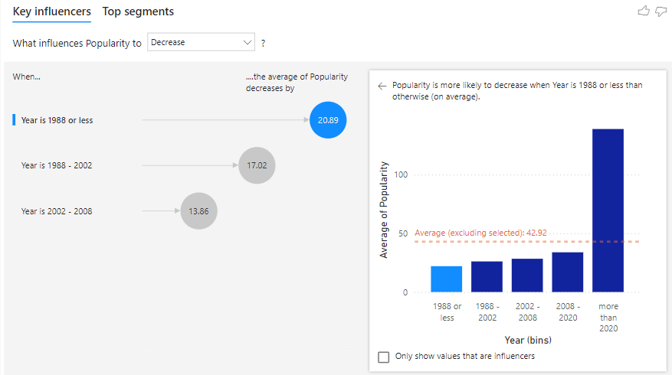
Key inference
This chart shows how the popularity of something (like movies, songs, etc.) changes over different years.
Left Side (Key Influencers):
It highlights three time periods:
1988 or earlier: The biggest drop in popularity (2039).
1988 - 2002: A smaller drop (1742).
2002 - 2008: An even smaller drop (1336).
Right Side (Opportunity):
It shows a bar graph of average popularity by year.
Popularity decreases more in earlier years (before 1989) compared to later years.
The dashed line represents the average popularity decrease, which is -432.
In simple terms, things from earlier years tend to lose popularity more than things from recent years.

Slide 12
Summary
Questions
Answers
What is the movie with highest popularity?
What is the movie with lowest popularity?
What is the most film Genre ?
What year was the largest number of films produced?
What movies took the highest rating?
What movies took the lowest rating?
Which language is most frequently used in movies?
Spider-Man: No Way Home is the highest popularity with 5083.954
Threads The United States vs. Billie Holiday is the lowest popularity with 13.354
Drama is the most movie type with count 3744
Year 2021 has the largest number of movies produced
Burn the Stage: The Movie and Bring the Soul: The Movie are the highest rating with Vote Average 8.9
Dragonball Evolution is the lowest rating with Vote Average 2.8
English is the most frequently used in movies with count 7571

Slide 13
Summery
Additional information
Popularity Trends: There are noticeable fluctuations in popularity, suggesting shifts in audience preferences or market trends over different periods.
Vote Counts: The distribution of vote counts shows varying levels of engagement, with some movies receiving significantly more attention than others.
Language Diversity: The original language distribution underscores the diversity of the movies in the dataset, showcasing a range of linguistic backgrounds.

Slide 14
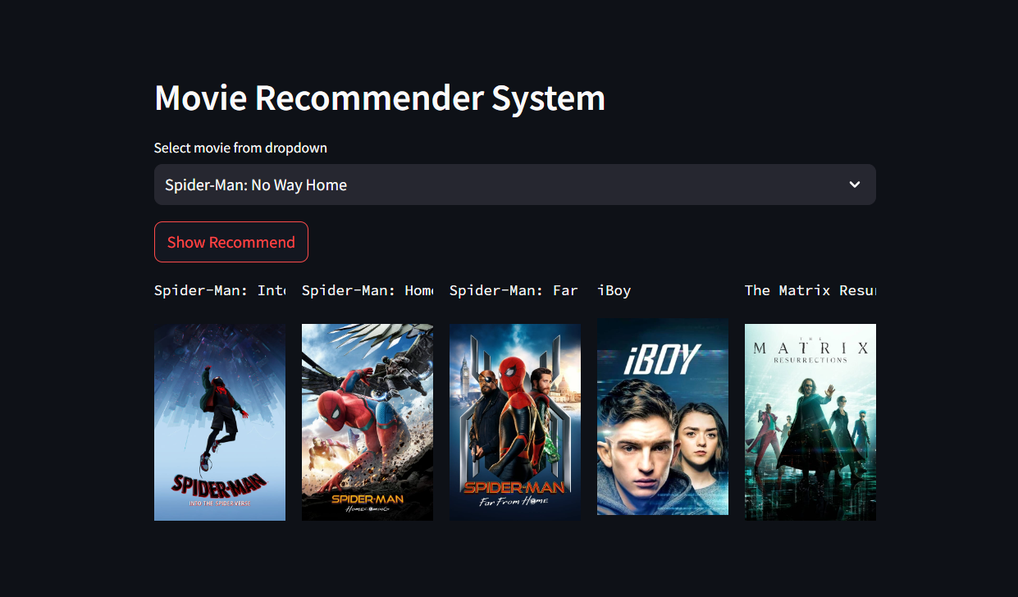
Movie recommender system

Slide 15
THANK YOU
Rawan Reda
rawanredag6b@gmail.com
linkedin.com/in/rawan-reda-479016284

